Slide 1
Structuring & Modeling Data
Jeremy Bergmann - Omaha Data Science Academy

Slide 2
Review: Class 3-5 – Data Manipulation
Creating new datasets & Combine disparate data sets
Perform common queries, aggregations, and joins
Adding, removing, or modifying data
Extracting and Storing Data
Creation/Extraction
Transformation data
Cleaning data
Storage & Retrieval
Notes:
Creation: creating tables and databases, the things
Storage: where data are stored
Cleaning: adding, removing, or modifying data
Retrieval: selecting only the data you want

Slide 3
Class 6 Objectives
Purpose of Database Modeling
Entity-Relationship Diagrams
SQL Constraints & Relational Database Modeling
Normal Forms: 1NF, 2NF, 3NF
Analytical Processing - Dimensional Data Modeling
Database Modeling – Sakila Database, Covid-19 Dataset
Notes:
Feynman technique: Learn -> Explain -> Reflect -> Repeat
What are the most important ideas from last class? Write a summary of the information as if explaining to a 14 year old. Avoid jargon Keep the words and sentences simple Rely on memory Make the explanation visual, if possible Note where you had difficulty or have knowledge gaps. These indicate things you should review, research, or ask questions about

Slide 4
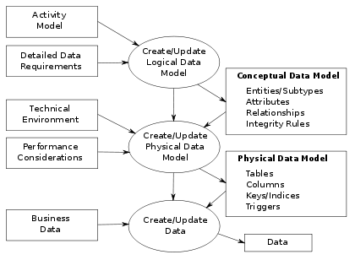
Database Modeling
On-Line Transaction Processing (OLTP) Database Modeling is focused on the operation of a particular system - goal is to design a DBMS that captures events.
A map of a database schema
Data modeling is a process for creating a database’s data model that focuses on the data. (vs. Data Science Modeling)
The model maps how information is stored and relates to other data.
Entity-relationship (ER) diagrams are formal mapping processes.
Notes:
Relationship: OLTP = Source for OLAP
Definition: https://database.guide/what-is-oltp/#:~:text=OLTP%20(Online%20Transactional%20Processing)%20is,a%20large%20number%20of%20users.
OLTP (Online Transactional Processing) is a category of data processing that is focused on transaction-oriented tasks. OLTP typically involves inserting, updating, and/or deleting small amounts of data in a database.
OLTP mainly deals with large numbers of transactions by a large number of users.

Slide 5
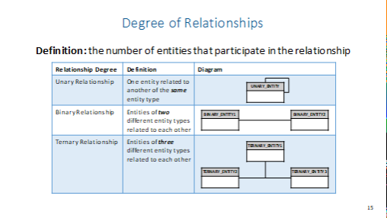
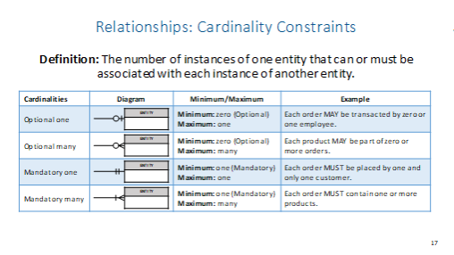
Entity-Relationship Diagrams (ERD)
ERD Diagrams describes interrelated entities of interest in a specific domain of knowledge, along with the relationships that exists between them.
Entities describes the business events of an organization
Attributes supports decision making, reporting, query, and analysis (i.e. describes business performance).
Relationships represents the key business entities upon which transactions are executed and the dimensions around which analysis is conducted (i.e. describes key business entities).

Slide 6
ERD Example - Business Rules
Following the requirements gathered in the previous section, the business rules, entities and relationships that will guide the constraints in the DBMS solution are as follows (Entities are in BOLD):
“Multiple vendors can have relationships with multiple owners, or no owners at all”
“Multiple owners can have relationships with multiple vendors, or none at all”
“A vendor can generate multiple service records or no service records at all”
“A service record must be attributed to only one business”
“A service record may contain many invoices, or none at all”
“multiple invoices must belong to only one service record”
“An invoice may contain many repair images, or no repair images at all”
“Multiple repair images must belong to only one invoice record”
“A Owner can approve multiple service records or no service records at all.”
“A service can be approved by only one Owner”
“A vendor must register for at least one (or many) accounts”
“Multiple accounts must be registered by only one vendor record”
“A repair subject can be contained in multiple service records, but must have at least one service record.”
“A service record must service only one repair subject.”
“Vendors can run multiple advertising/market campaigns or no campaigns at all.”

Slide 7
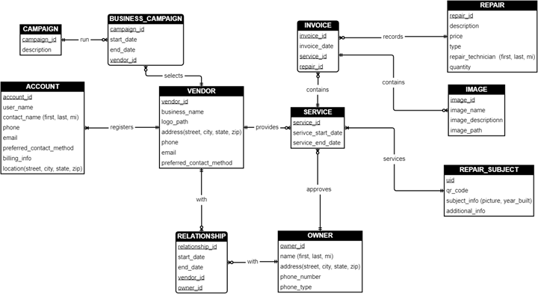
ERD Example - Diagram

Slide 8
SQL Constraints
Constraints are the rules enforced on the data columns of a table. These are used to limit the type of data that can go into a table. This ensures the accuracy and reliability of the data in the database.
PRIMARY Key − Uniquely identifies each row/record in a database table. FOREIGN Key − Uniquely identifies a row/record in any of the given database table. CHECK Constraint - The CHECK constraint ensures that all the values in a column satisfies certain conditions.
NOT NULL Constraint − Ensures that a column cannot have NULL value. DEFAULT Constraint − Provides a default value for a column when none is specified. UNIQUE Constraint − Ensures that all values in a column are different.
INDEX − Used to create and retrieve data from the database very quickly.

Slide 9
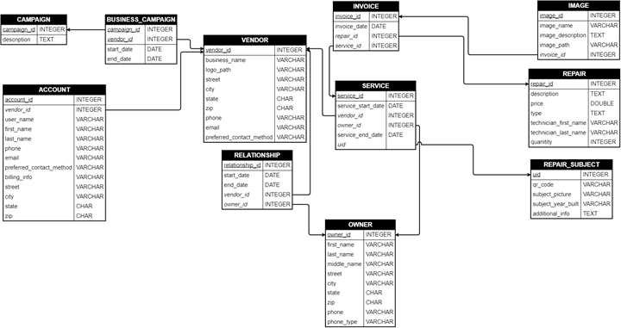
Relational Database Modeling
Relational Database models convert the conceptual representation of entities (ERD) to a model that can be implemented directly in a database (Physical Model).
Notes:
For example, a company may house all their data in a SQL Server database, but needs to gather their source data from Excel, CSV, Access, and JSON files. With ETL, you can take this disparate information, pull it into a staging area where you transform it, then write all the data into the target data store.

Slide 10
Normal Forms
Normal forms are standard rules for structuring a database to reduce redundancy and increase data integrity. In essence, the rules serve to minimize space costs and error costs. Denormalization involves selectively increasing redundancy to improve speed performance and reduce query complexity.
Every non-prime key attribute must provide a fact about the key, the whole key, and nothing but the key.
1NF: first normal form
2NF: second normal form
3NF: third normal form

Slide 11
1st Normal Form
Requirement: The table has a primary key
Rules:
1. Each attribute (column) value must be a single value only. 2. All values for a given attribute (column) must be of the same type. 3. Each attribute (column) name must be unique. 4. The order of attributes (columns) is insignificant 5. No two tuples (rows) in a relation can be identical. 6. The order of the tuples (rows) is insignificant.
Company | Symbol | Headquarters | Date | Close Price
Microsoft | MSFT | Redmond, WA | 09/07/2013 | 23.96
Microsoft | MSFT | Redmond, WA | 09/08/2013 | 23.93
Microsoft | MSFT | Redmond, WA | 09/09/2013 | 24.01
Oracle | ORCL | Redwood Shores, CA | 09/07/2013 | 24.27
Oracle | ORCL | Redwood Shores, CA | 09/08/2013 | 24.14
Oracle | ORCL | Redwood Shores, CA | 09/09/2013 | 24.33
Example relation in 1NF (note that key attributes are underlined): STOCKS (Company, Symbol, Headquarters, Date, Close_Price)

Slide 12
2nd Normal Form
1NF
Requirement: The table(s) are in 1NF
Rules:
A relation is in second normal form (2NF) if all of its non-key attributes are dependent on all of the key.
Another way to say this: A relation is in second normal form if it is free from partial-key dependencies
Relations that have a single attribute for a key are automatically in 2NF.
This is one reason why we often use artificial identifiers (non-composite keys) as keys.
Company | Symbol | Headquarters | Date | Close Price
Microsoft | MSFT | Redmond, WA | 09/07/2013 | 23.96
Microsoft | MSFT | Redmond, WA | 09/08/2013 | 23.93
Microsoft | MSFT | Redmond, WA | 09/09/2013 | 24.01
Oracle | ORCL | Redwood Shores, CA | 09/07/2013 | 24.27
Oracle | ORCL | Redwood Shores, CA | 09/08/2013 | 24.14
Oracle | ORCL | Redwood Shores, CA | 09/09/2013 | 24.33
2NF
Company | Symbol | Headquarters
Microsoft | MSFT | Redmond, WA
Oracle | ORCL | Redwood Shores, CA
Symbol | Date | Close Price
MSFT | 09/07/2013 | 23.96
MSFT | 09/08/2013 | 23.93
MSFT | 09/09/2013 | 24.01
ORCL | 09/07/2013 | 24.27
ORCL | 09/08/2013 | 24.14
ORCL | 09/09/2013 | 24.33
Company relation
FD1: Symbol → Company, Headquarters
STOCK_PRICES relation FD1: Symbol, Date → Close Price

Slide 13
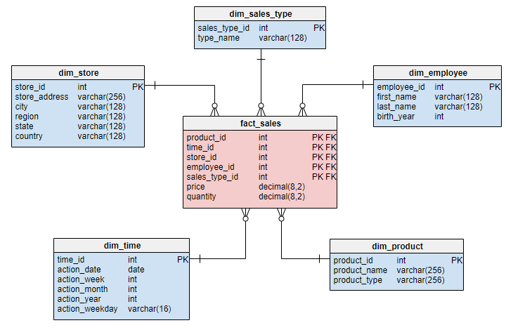
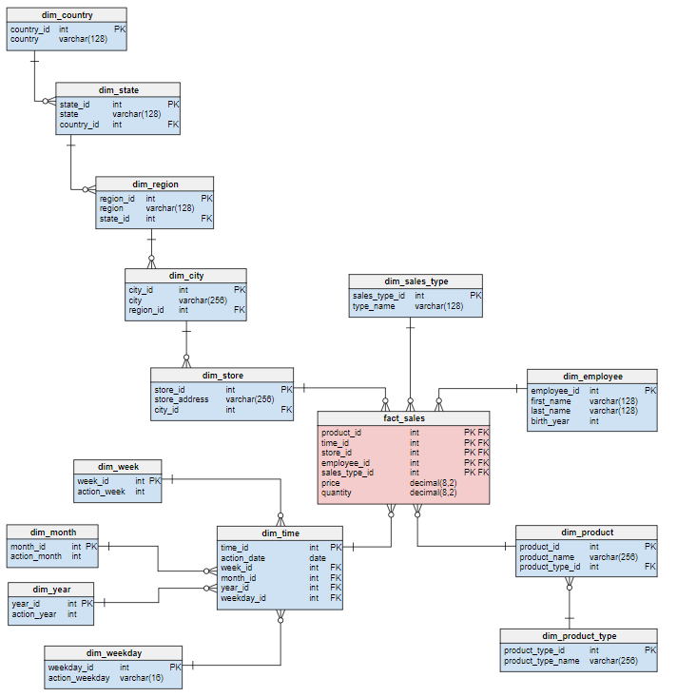
OLAP - Dimensional Data Modeling
Star Schema
Snowflake Schema
Advantage: Simple to model and understand, Simple queries, Fast.
Disadvantage: Increased space cost and data integrity risk due to redundancies.
Advantage: Low data integrity risk,Minimal space cost.
Disadvantage: Increased query complexity, Decreasing performance as number of joins increases.
Notes:
What is difference between OLAP and OLTP?
OLTP is a transactional processing while OLAP is an analytical processing system. ...
The basic difference between OLTP and OLAP is that OLTP is an online database modifying system, whereas, OLAP is an online database query answering system.

Slide 14
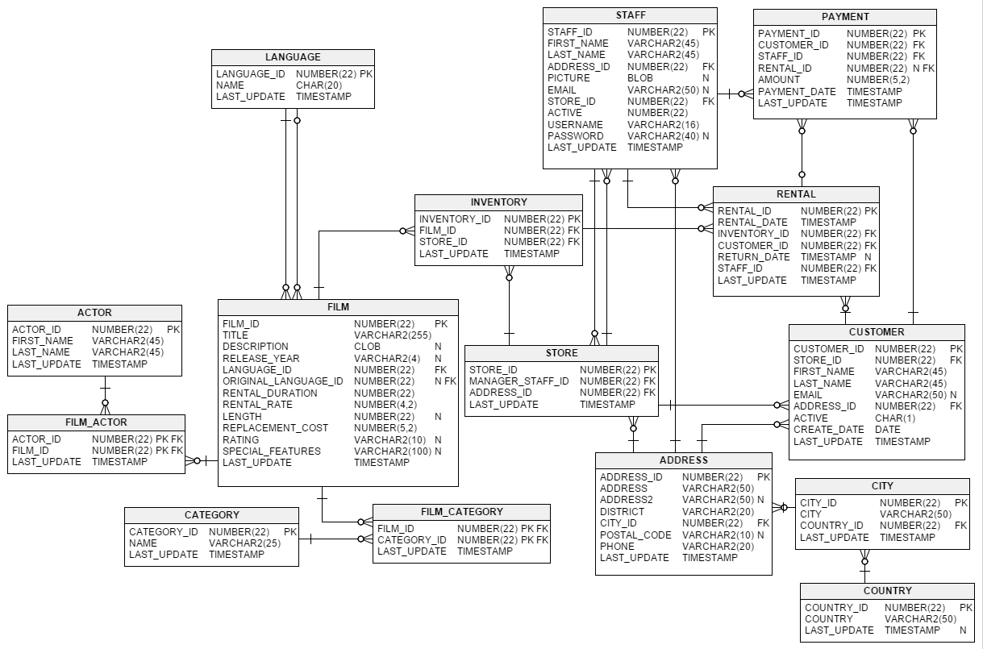
Exercise – Sakila Schema
Objective - Utilize the Sakila Schema to identify the following:
1. Identify the ENTITIES and ATTRIBUTES of the schema.
2. Is the FILM table in 1st normal form? If so, why?
3. Can you name a relationship that is in (at least) 2nd normal form?
4. Find the following relationships in the schema:
a) Mandatory One→ Optional Many
b) Optional One → Optional Many
Notes:
One of the best example databases out there is the Sakila Database, which was originally created by MySQL and has been open sourced under the terms of the BSD License.
The Sakila database is a nicely normalised schema modelling a DVD rental store, featuring things like films, actors, film-actor relationships, and a central inventory table that connects films, stores, and rentals.

Slide 15
Project Milestones
Import data into MySQL database (Class 1)
Query Data for Data Understanding/Relevant Information (Class 2)
Storing/Joining data for analysis (Class 3-4)
Cleaning Data (Class 5)
Create Stored Procedures to Automate Queries (Class 6)
Normalize Data & Create Data Model (Class 7)
Analyze Data Quality & Create Data Dictionary (Class 8)
Connect Data to PowerBI Desktop/Cloud, Answer Business Questions (Class 8)

Slide 16

Class Project
ERD using Draw.IO
Entity Relationship Diagram
1. Identifies the Entities (Nouns), Attributes (Adjectives) and relationships (verbs) in the “console” schema.
2. Create an ERD diagram in draw.io
Relational Database Modeling
1. Convert the ERD diagram to a relational model, using draw.io
2. Convert the relation model to an OLAP dimensional model, identifying the business entities (dimensions) and measures (facts)
3. Once designing and normalization of the database is complete, create the SQL code (via views) that creates the OLAP relationship between tables.
Example at: https://drive.google.com/file/d/1Y9GhKlDneFCqDSSHyWLC09beGWrC0qpc/view

Slide 17
Appendix - 3rd Normal Form
2NF
Company | Symbol | Headquarters
Microsoft | MSFT | Redmond, WA
Oracle | ORCL | Redwood Shores, CA
Symbol | Date | Close Price
MSFT | 09/07/2013 | 23.96
MSFT | 09/08/2013 | 23.93
MSFT | 09/09/2013 | 24.01
ORCL | 09/07/2013 | 24.27
ORCL | 09/08/2013 | 24.14
ORCL | 09/09/2013 | 24.33
Prerequisite: Table is in 2NF Rule:
Every non-prime attribute is non-transitively dependent on every candidate key (ex. Company, Symbol, Date)
Stated otherwise:
1) Each field is either part of a key or directly dependent on the key
2) Table columns do not have transitive dependency
Company relation
FD1: Symbol → Company, Headquarters
STOCK_PRICES relation FD1: Symbol, Date → Close Price
3NF
Company | Symbol
Microsoft | MSFT
Oracle | ORCL
Company | Headquarters
Microsoft | Redmond, WA
Oracle | Redwood Shores, CA
STOCK_SYMBOLS Relation
FD1: Symbol → Company
COMPANY_HEADQUARTERS
FD1: Symbol →Headquarters
The functional dependencies we can see are: FD1: Symbol → Company FD2: Company → Headquarters
so therefore: Symbol → Headquarters
Notes:
Note that the key (which consists of the Symbol and the Date) can uniquely determine the Company, Headquarters and Close Price of the stock. Here was assume that Symbol must be unique but Company, Headquarters, Date and Price are not unique.

Slide 18


